Slide 1
CS304 – Operating Systems: Course administration & details
Anirban Mondal
Associate Professor, Ashoka University
PhD, National University of Singapore (NUS)
MBA, University of Massachusetts Amherst (UMass)
BTech CSE IIT Kharagpur
anirban.mondal@ashoka.edu.in

Slide 2
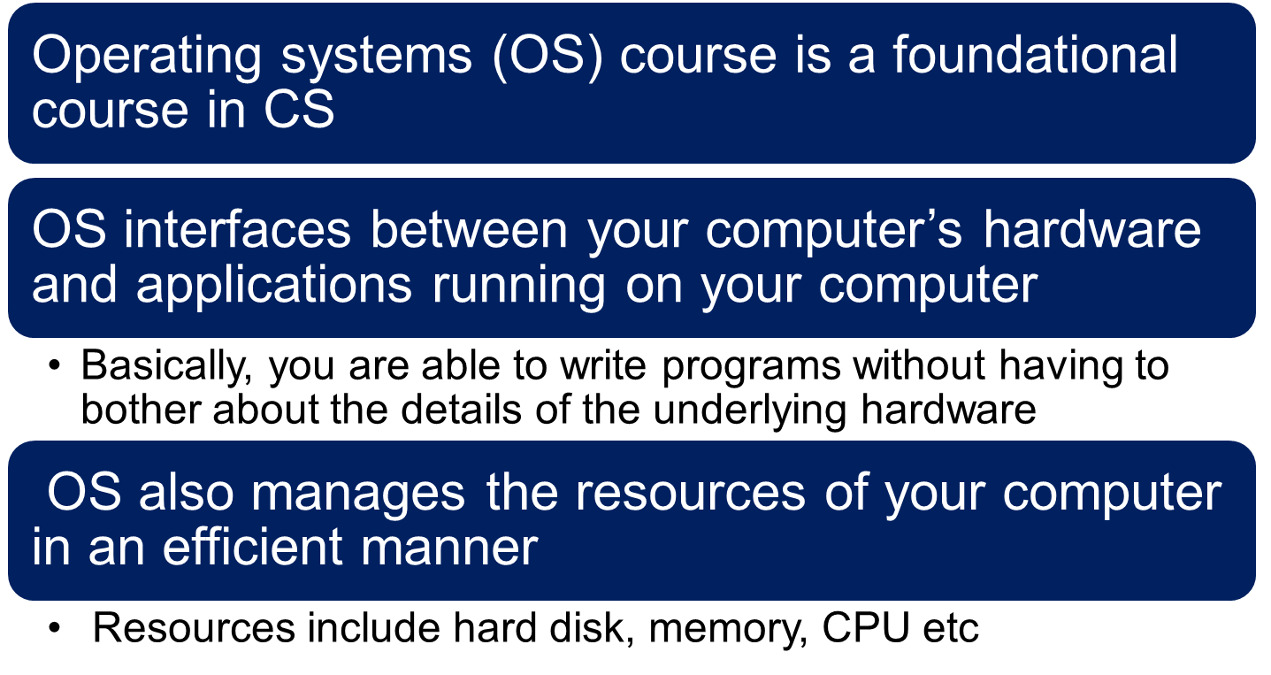
Course Description
The goal of this course is to equip students in the fundamentals of operating systems

Slide 3
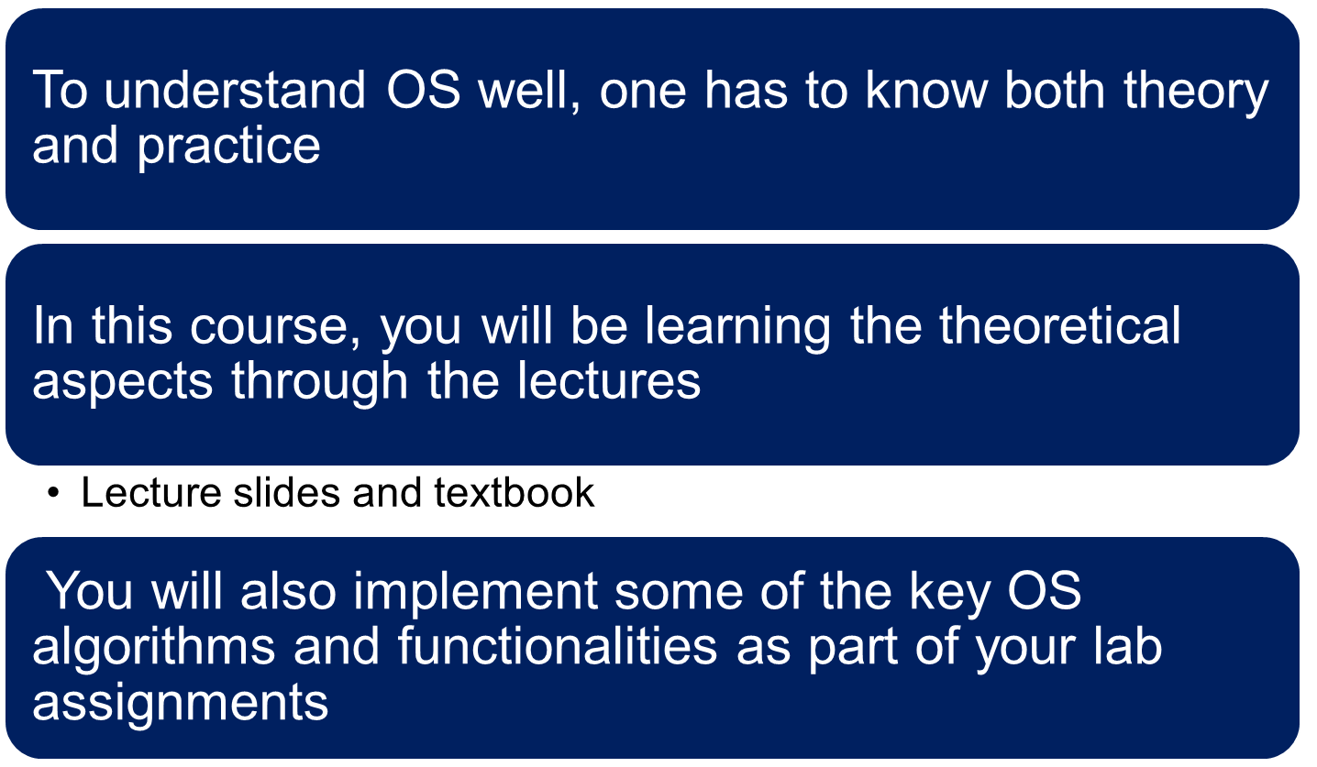
Key information about the course

Slide 4
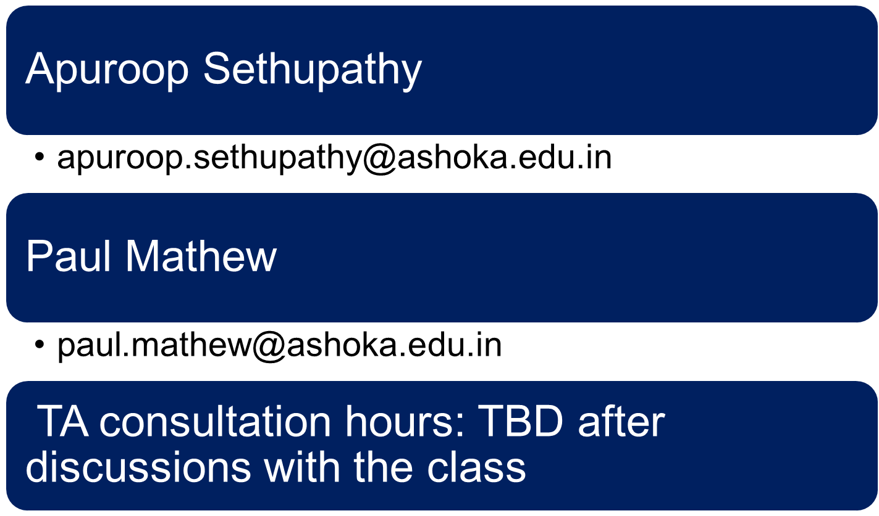
Your TAs

Slide 5
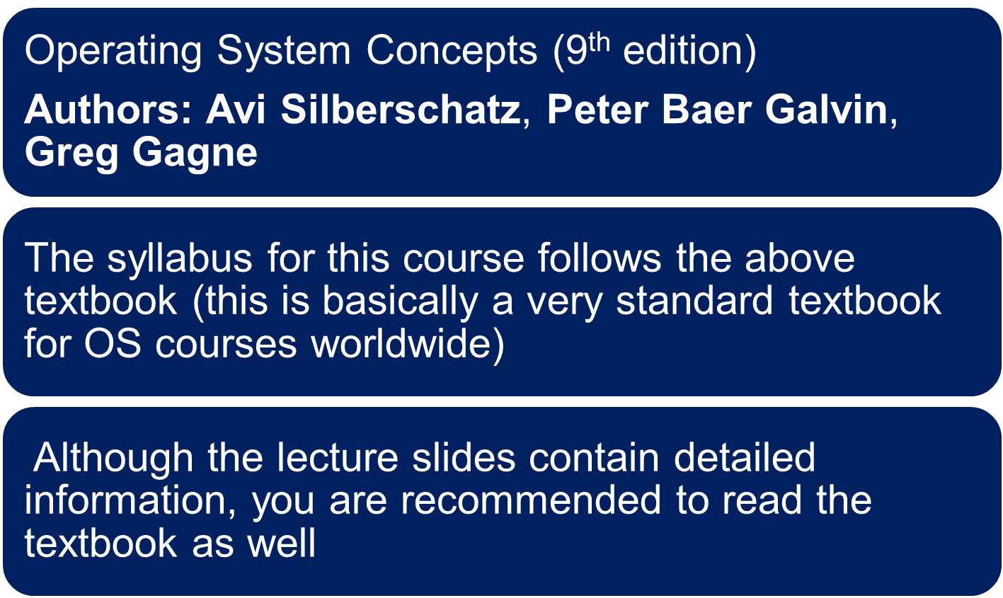
Prescribed Textbook for the course

Slide 6
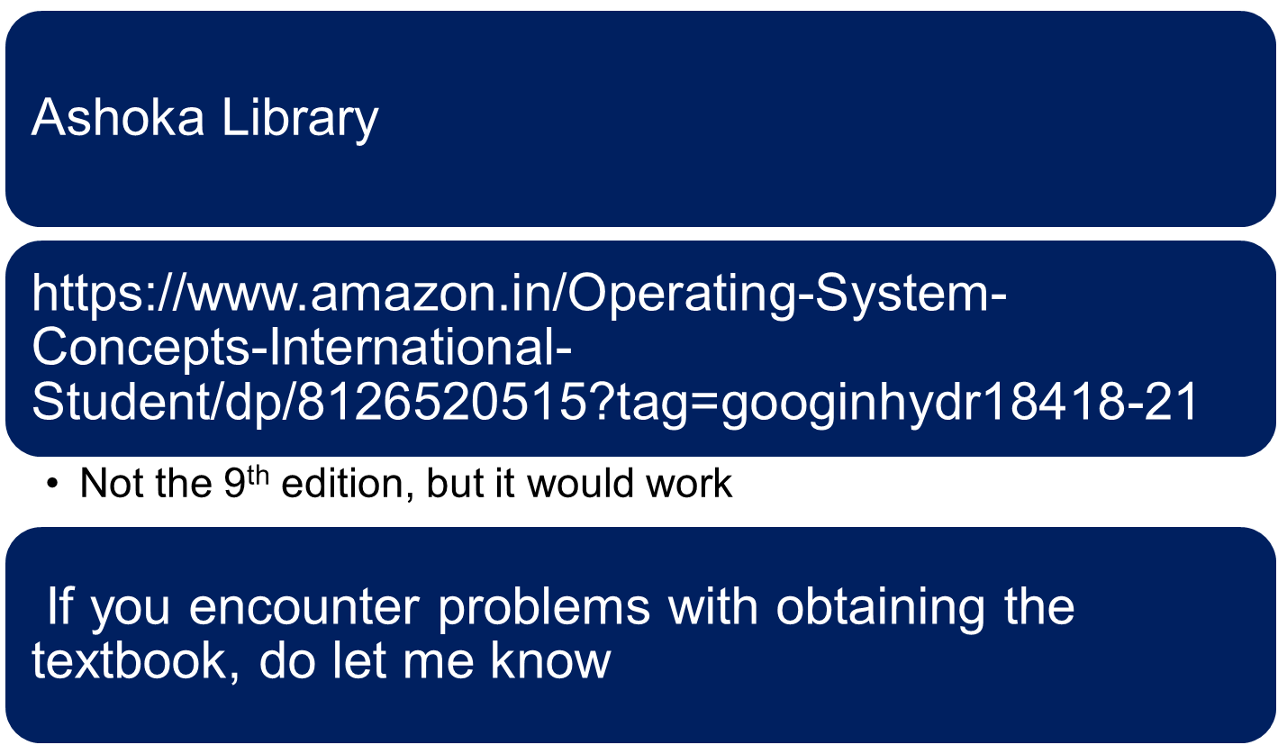
Obtaining access to the textbook

Slide 7
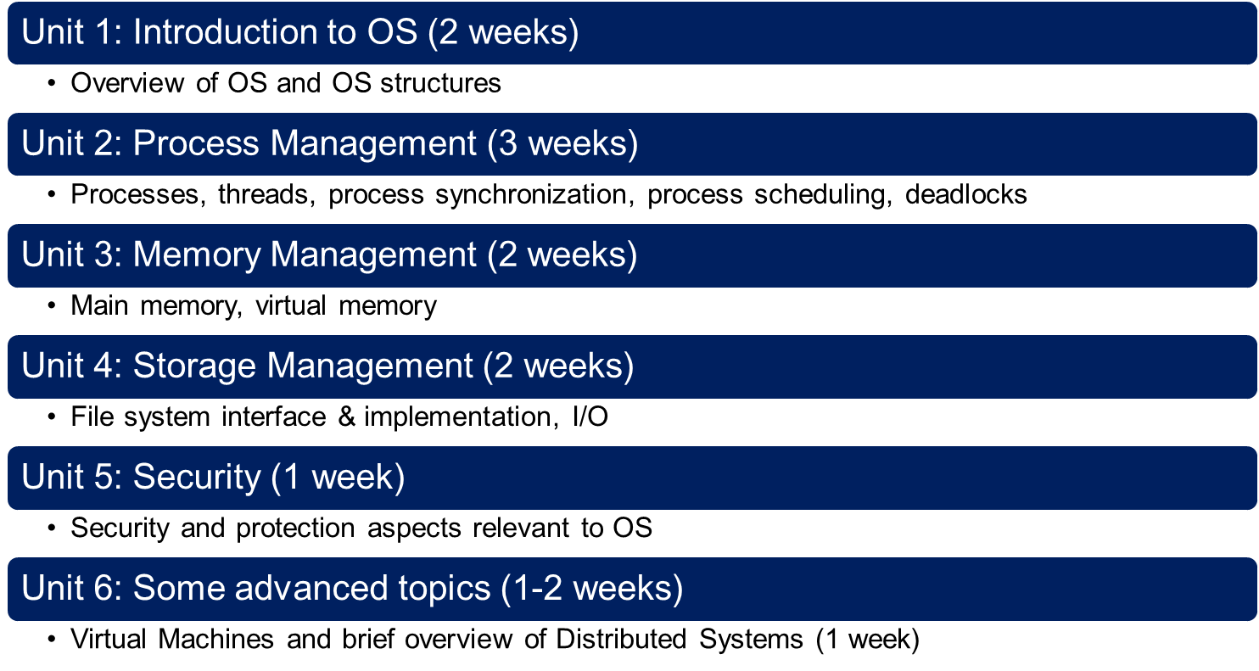
Course Contents
The duration assigned to each unit of the course is approximate; the syllabus is based on the prescribed textbook

Slide 8
Grading Scheme
Evaluation Instrument | Weightage
Midterm Exam | 20%
Quizzes & assignments | 15%
Class participation | 10%
Laboratory | 25%
End-term Exam | 30%

Slide 9
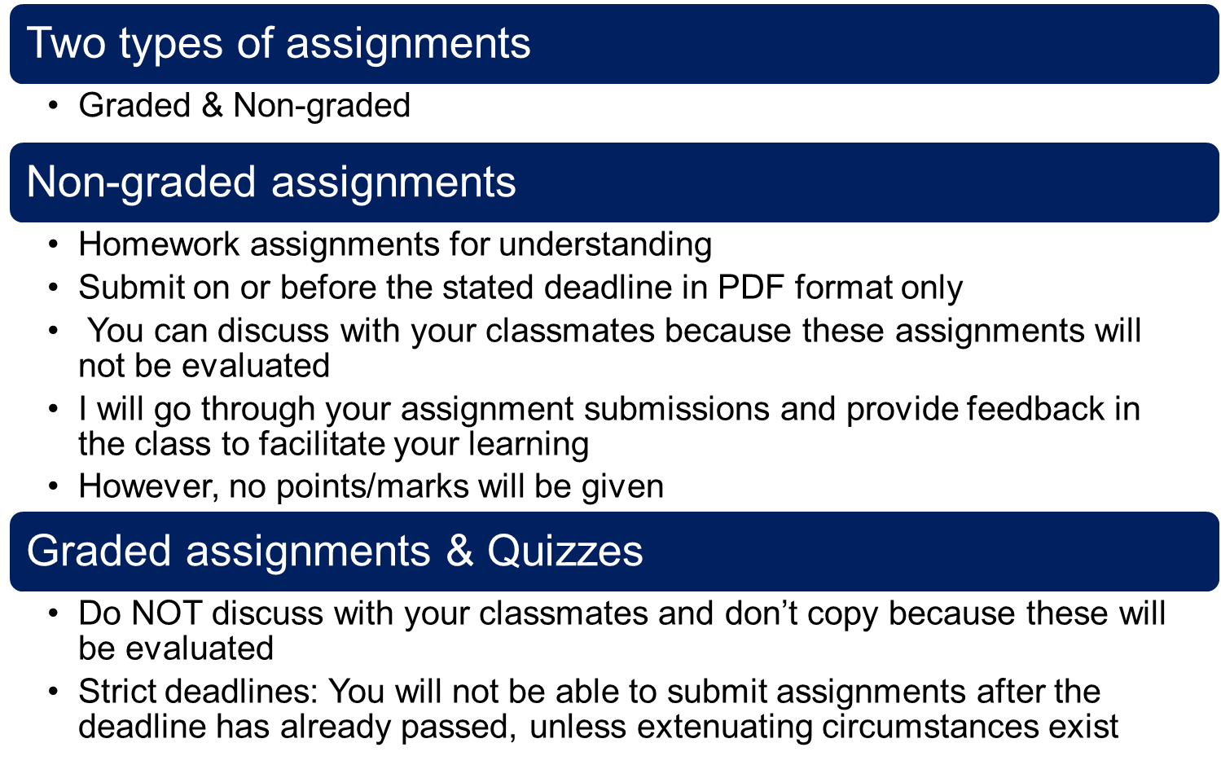
Assignments & Quizzes

Slide 10
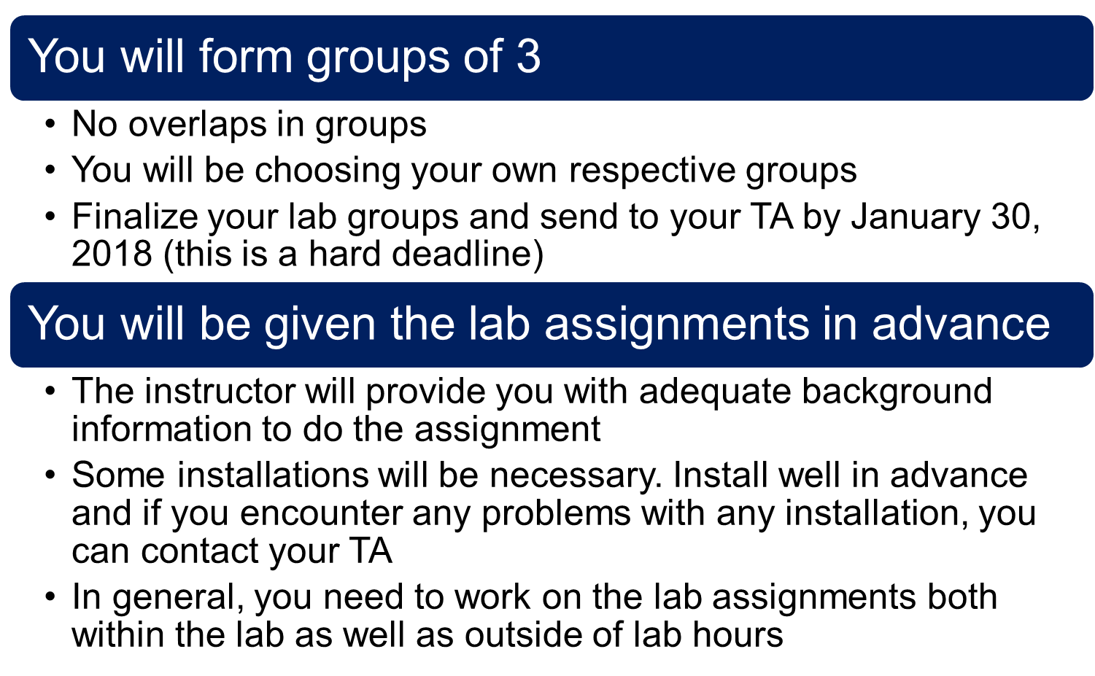
Lab Assignments

Slide 11
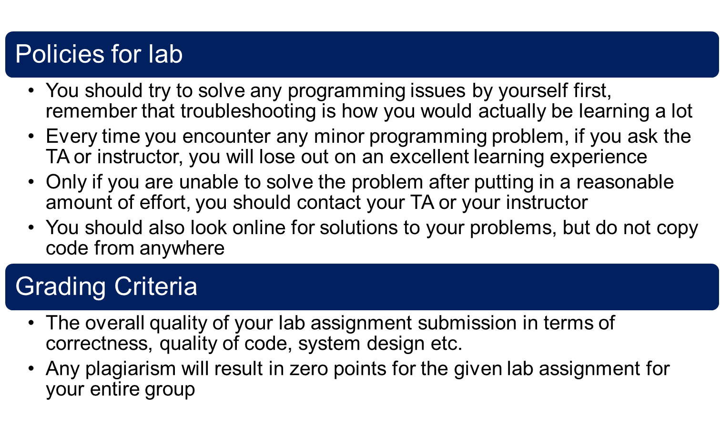
Lab Assignments

Slide 12
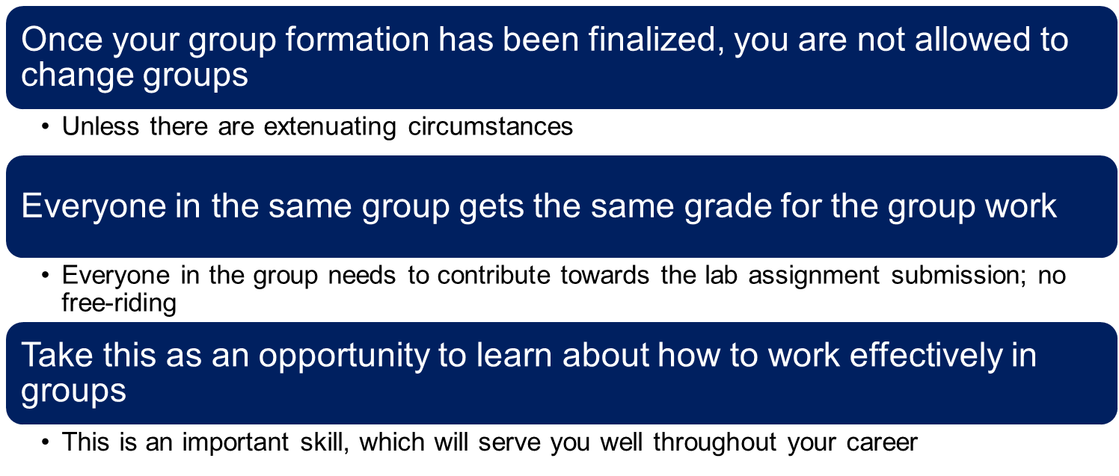
Forming your lab groups

Slide 13

Class/Lab timings & Venue

Slide 14
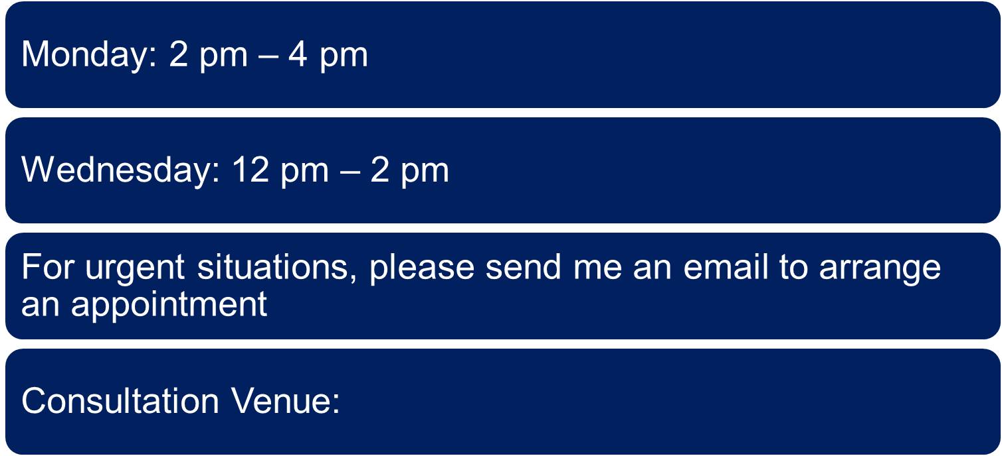
Consultation hours

Slide 15
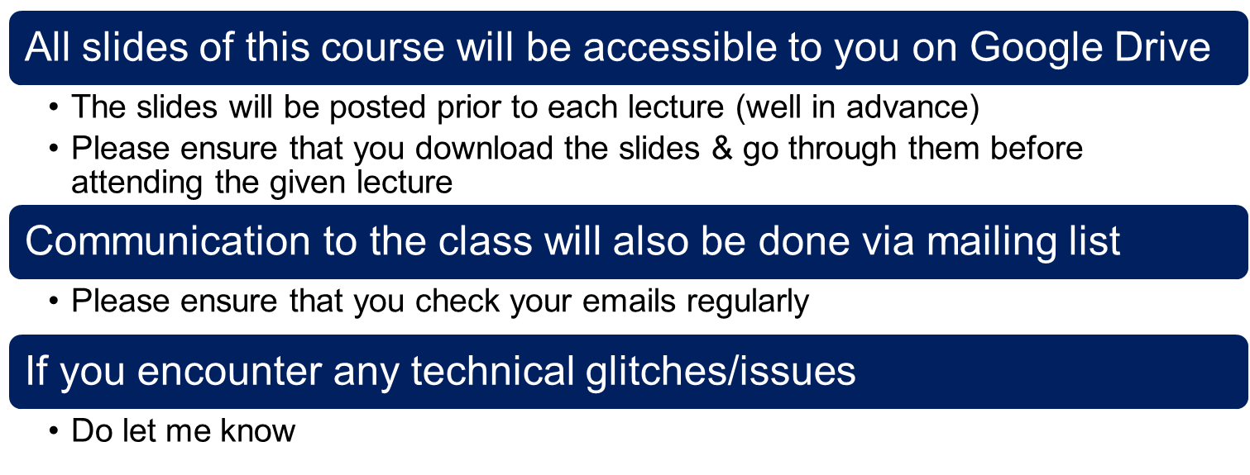
Slides uploads and communication

Slide 16
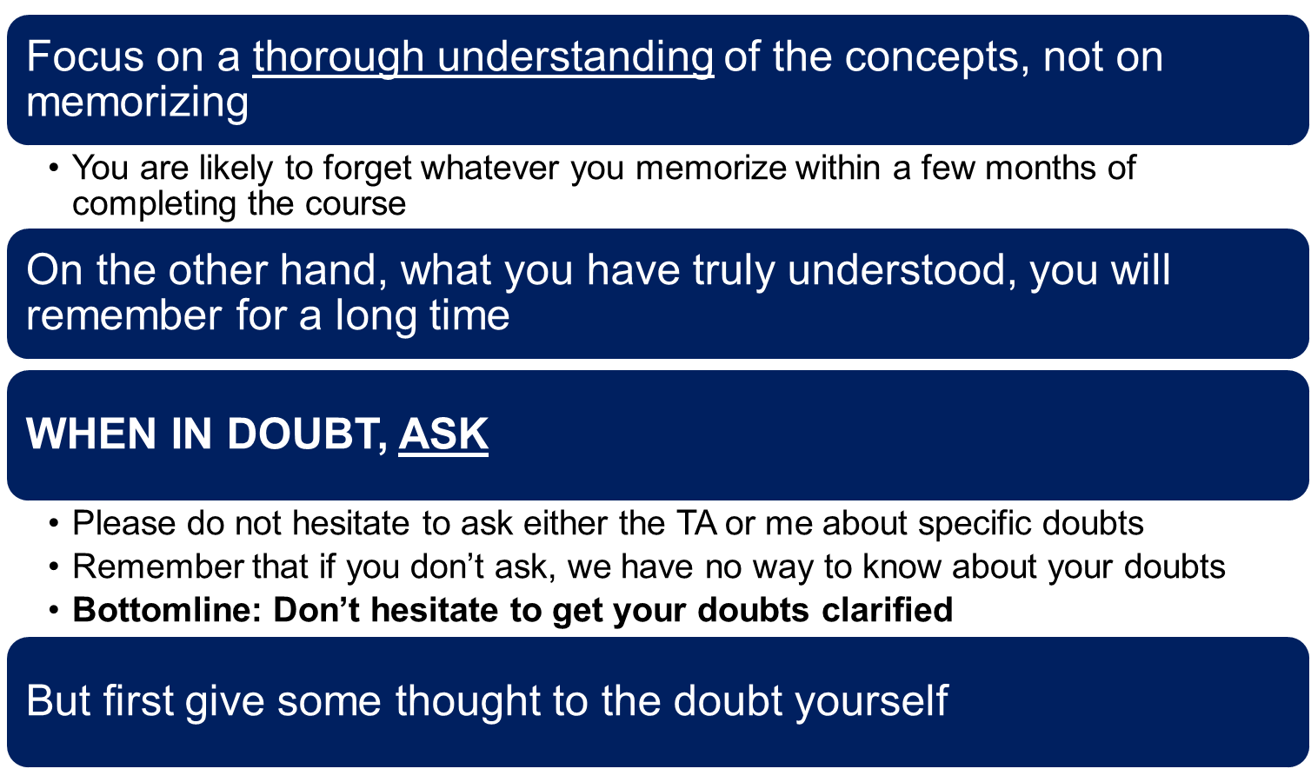
Maximizing your benefits from the course

Slide 17
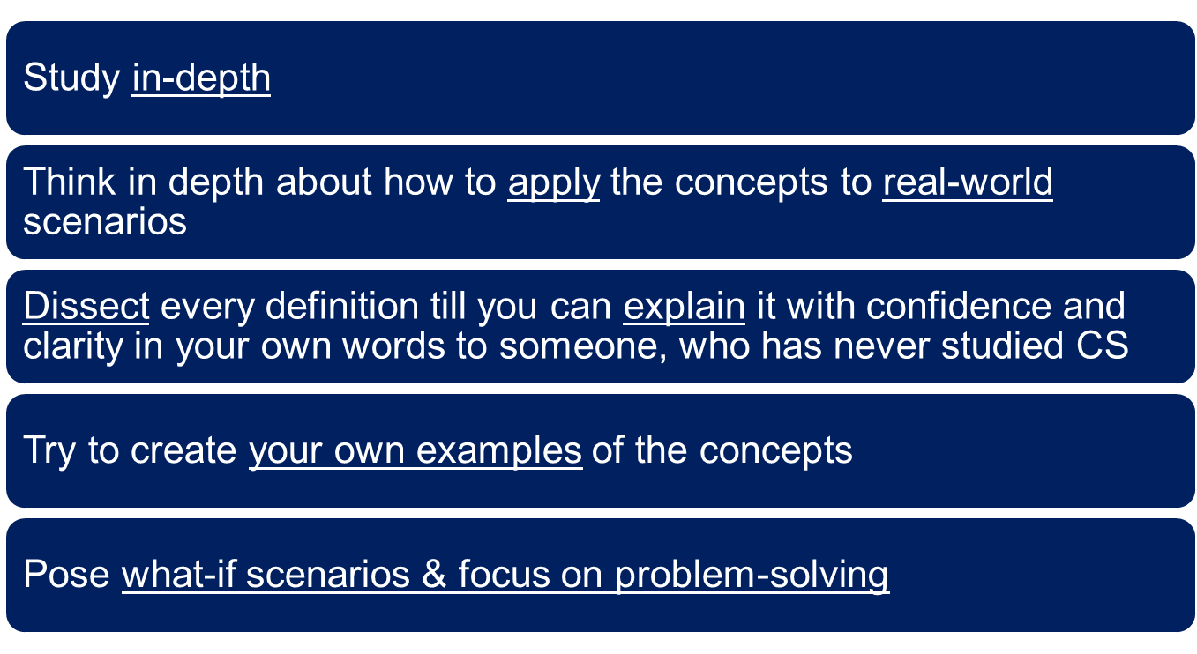
Maximizing your benefits from the course (Cont.)

Slide 18
Look at the next two slides to understand why applying your knowledge in assignments/projects/exams etc is important for your overall learning experience

Slide 19
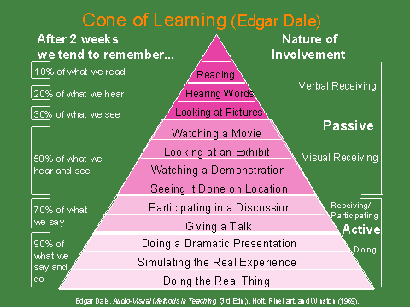
Source: http://www.cals.ncsu.edu/agexed/sae/ppt1/sld012.htm

Slide 20
Bottomline: Do the assignments sincerely because it will facilitate you in INTERNALIZING the ideas/techniques you learnt in this course.
Source: http://www.cals.ncsu.edu/agexed/sae/ppt1/sld012.htm

